Slide 1
Big Mart Sales Analysis and Prediction
Presented By: Hall Ticket No:

Slide 2
Project analysis slide 2
Project Components
Data Preparation
Feature Engineering
PROJECT
Data Pre-Processing
Model Building
EDA
Model Evaluation

Slide 3

Project analysis slide 11
Introduction of the
Project
Overview of the Project:
This project is focused on analysing and predicting sales for various products across multiple retail outlets. By leveraging a comprehensive dataset from an open-source platform, the project aims to build robust machine learning models that can forecast sales with high accuracy.
Importance of Sales Prediction in Retail:
Accurate sales prediction is a cornerstone of effective retail management. In the highly competitive retail industry, understanding future sales trends allows businesses to optimize their supply chains, reduce waste, and align marketing strategies with consumer demand.
Objectives of the Project:
Primary Objective: Develop a predictive model capable of accurately forecasting sales across various retail outlets using advanced machine learning techniques.

Slide 4

Project analysis slide 11
Problem
Statement
Challenges in Retail Sales Prediction:
Variability in consumer behaviour and market conditions.
Managing large, complex datasets with numerous influencing factors.
Difficulty in capturing seasonal trends and external factors like promotions.
Impact of Accurate Sales Forecasting:
Inventory Management: Reduces overstocking and stockouts, optimizing storage and supply chain efficiency.
Marketing Strategies: Enhances targeted promotions and pricing strategies, aligning with predicted demand to maximize revenue.

Slide 5
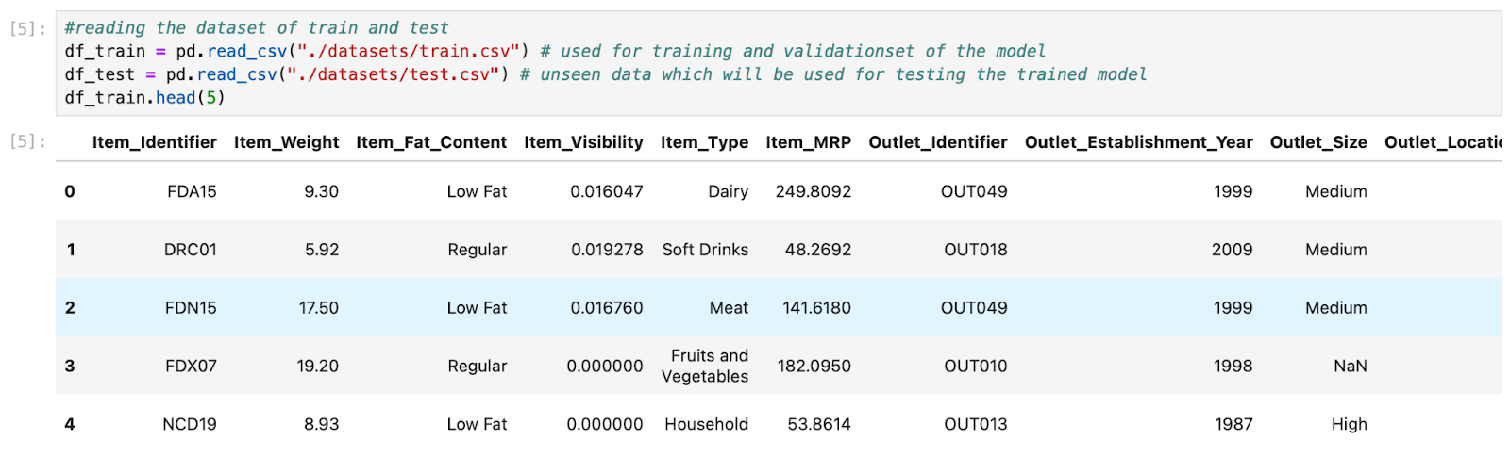
Project analysis slide 11
Dataset
Overview
Description of the Dataset:
Total Records: 8,523 in the training set, 5,681 in the test set.
Features: 12 features including product and outlet attributes.
Key Attributes:
Item_Visibility: Visibility of a product on the shelf.
Item_Weight: Weight of each product in kilograms.
MRP (Maximum Retail Price): Highest price at which the product is sold.
Outlet Information: Includes Outlet_Type, Outlet_Size, and Outlet_Location_Type.

Slide 6
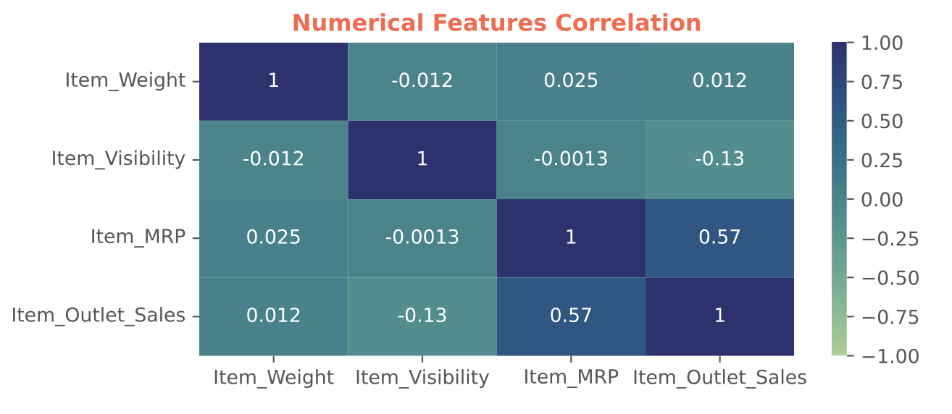
Project analysis slide 11
Exploratory Data
Analysis
Key Findings:
Univariate Analysis: Identified skewness in features like Item_Visibility and Item_Outlet_Sales.
Bivariate/Multivariate Analysis:
Positive correlation between Item_MRP and sales.
Negative correlation between Item_Visibility and sales.
Significant differences in sales across Outlet_Type categories.
Observations:
Data Distribution: Most features show right-skewed distributions, particularly Item_Visibility and Item_Outlet_Sales.
Outliers: Detected in Item_Visibility and Item_Outlet_Sales, which were handled to improve model accuracy.
Correlations: Strongest positive correlation between Item_MRP and sales; weak correlations observed with other features.

Slide 7
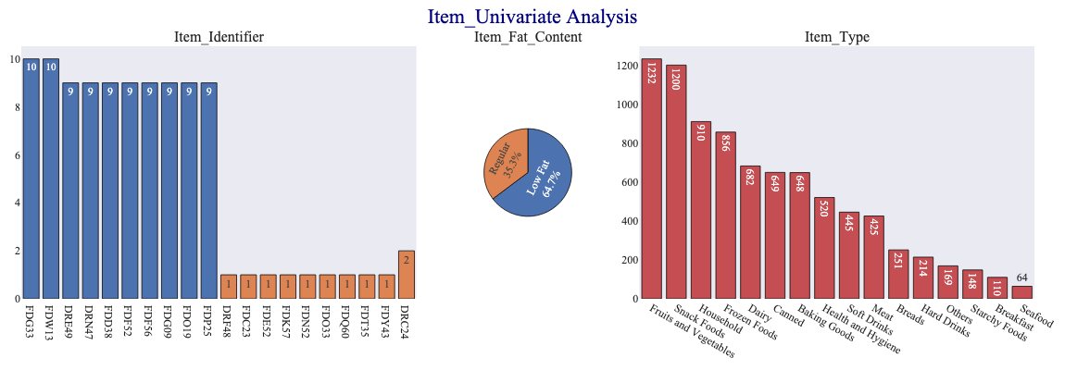
Project analysis slide 11
Item Univariate
Analysis
Item Identifier Distribution:
The Item_Identifier plot shows that certain products are much more frequent than others, with some items appearing up to 10 times. This suggests that these products might be more popular or have broader availability across outlets.
Item Fat Content Analysis:
The pie chart indicates that the majority of items are categorized as Low Fat (63.7%), with the remainder split between Regular (36.3%). This skew could impact sales trends, particularly in health-conscious consumer segments.
Item Type Distribution:
The bar chart reveals that Fruits and Vegetables, Snack Foods, and Household items are the most common types in the dataset, which may indicate higher demand or inventory levels for these categories.

Slide 8
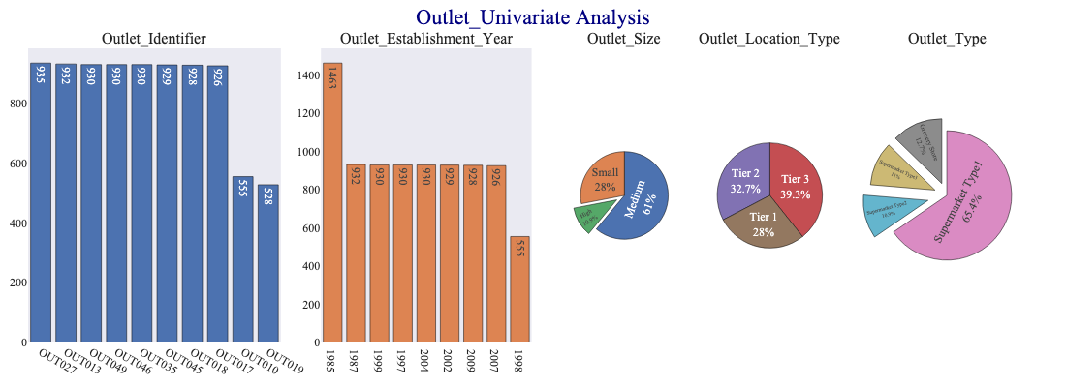
Project analysis slide 11
Outlet Univariate
Analysis
Outlet Identifier Distribution: The Outlet_Identifier plot shows that most outlets have a similar number of products, except for OUT019, which has significantly fewer items. This could reflect a smaller store size or specialized product offerings.
Outlet Establishment Year: The bar chart for Outlet_Establishment_Year highlights that older outlets, particularly those established in 1985, have the highest number of recorded items. This may suggest that older stores have a more established customer base and inventory system.
Outlet Size and Type: The pie charts indicate that most outlets are of medium size (61%) and are located in Tier 2 and Tier 3 locations, with the majority being Supermarket Type1 (65.4%). This distribution could influence sales patterns and marketing strategies, with different outlet types catering to varied customer needs.

Slide 9
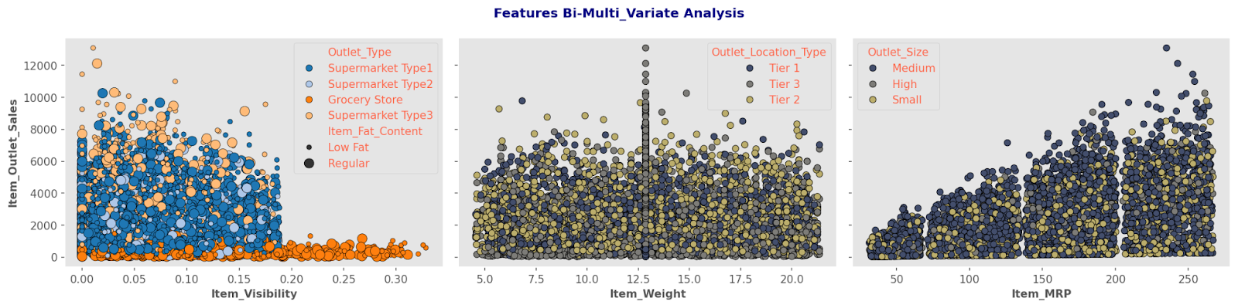
Project analysis slide 11
Bi-Multi variate
Analysis
Item Visibility vs. Sales: The scatter plot shows that Item_Visibility has a weak negative correlation with Item_Outlet_Sales. Products with lower visibility tend to have higher sales, possibly due to being more sought after by customers, reducing the need for high visibility.
Item Weight vs. Sales: The relationship between Item_Weight and Item_Outlet_Sales appears to be weak, with no clear trend. This suggests that weight is not a significant factor in predicting sales, but there are slight variations depending on the Outlet_Location_Type.
Item MRP vs. Sales: A clear positive correlation is observed between Item_MRP and Item_Outlet_Sales. Higher-priced items generally result in higher sales, indicating that MRP is a strong predictor of sales, especially in medium and high-sized outlets.

Slide 10
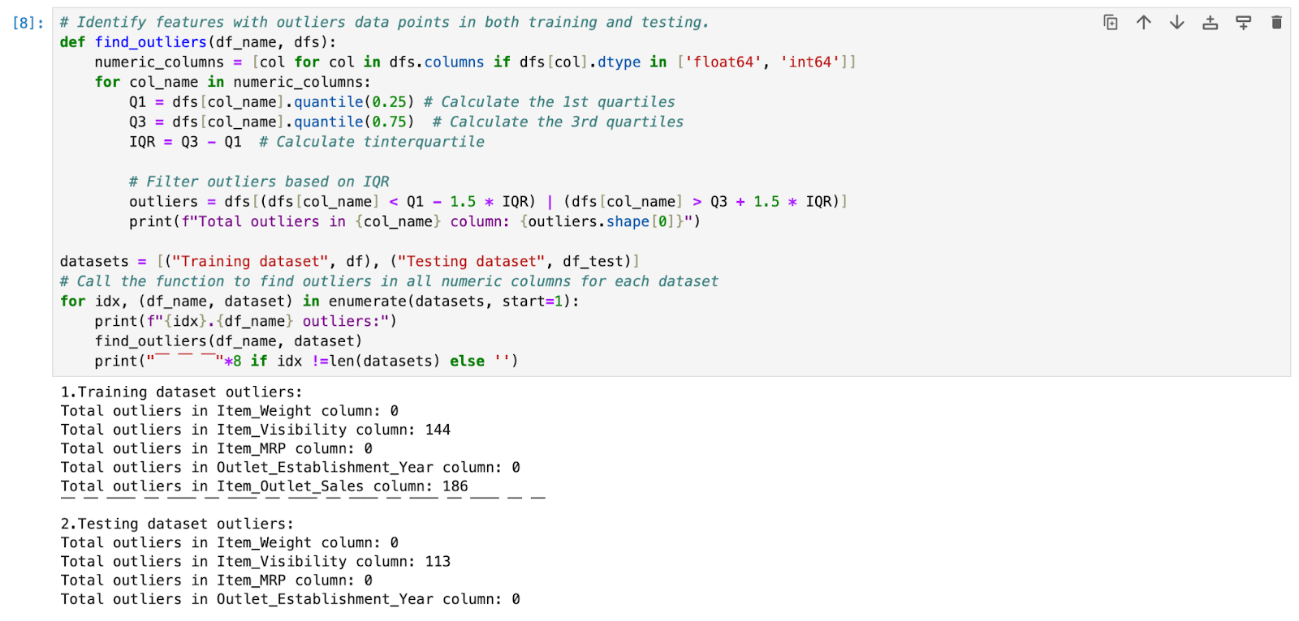
Project analysis slide 11
Data
Pre-Processing
Handling Missing Values:
Item_Weight: Imputed missing values with the mean.
Outlet_Size: Filled missing values using the mode.
Outliers Detection:
Detected and addressed outliers in Item_Visibility and Item_Outlet_Sales using appropriate transformations.

Slide 11
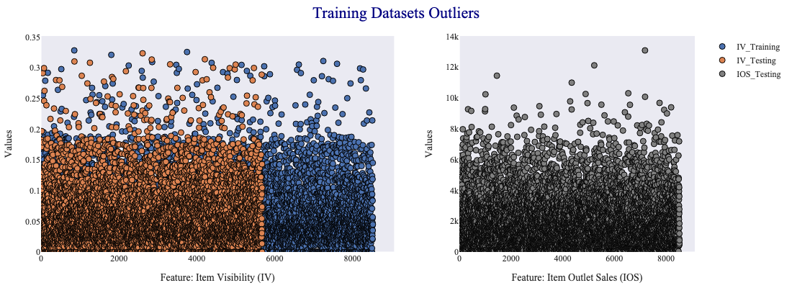
Project analysis slide 11
Handling Outliers
In Data
Identifying Outliers:
Outliers were detected in key features like Item_Visibility and Item_Outlet_Sales. These outliers can distort the model's accuracy and are often the result of data entry errors or extreme cases.
Treatment of Outliers:
Outliers were handled using transformation techniques such as log transformation and capping. These methods help in bringing the outliers closer to the majority of the data distribution.

Slide 12
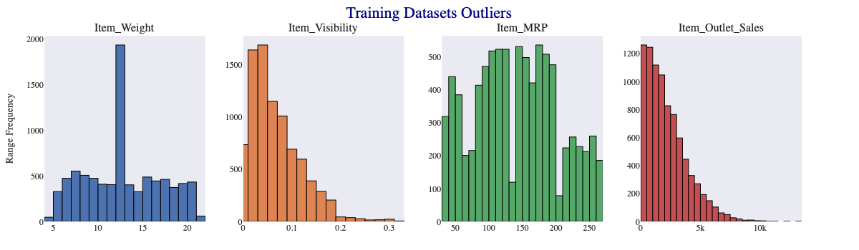
Project analysis slide 11
Bivariate Analysis
In the Dataset
Item MRP vs. Sales:
A strong positive correlation was observed between Item_MRP and Item_Outlet_Sales, indicating that higher-priced items tend to generate higher sales.
Item Visibility vs. Sales:
There was a negative correlation between Item_Visibility and Item_Outlet_Sales, suggesting that items with lower visibility on shelves tend to have lower sales.
Outlet Type vs. Sales:
Sales varied significantly across different Outlet_Type categories, with some outlet types consistently outperforming others in terms of sales volume.

Slide 13
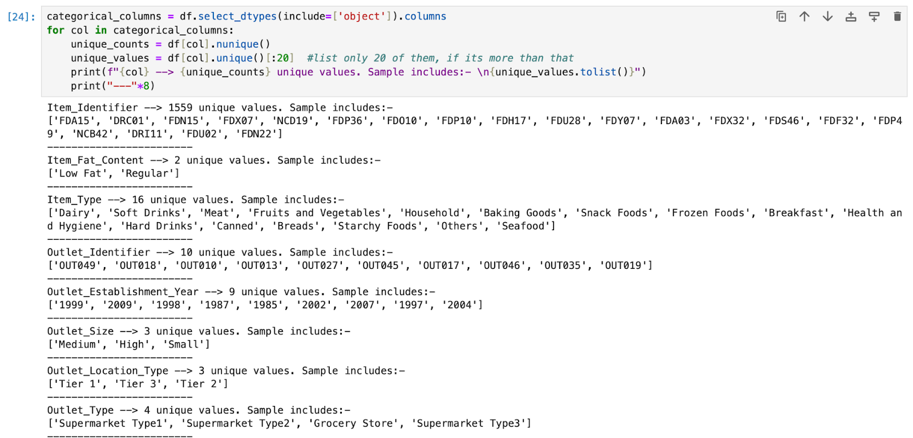
Project analysis slide 11
Feature
Engineering
Encoding Categorical Variables:
Label Encoding: Applied to features like Item_Fat_Content and Outlet_Type.
One-Hot Encoding: Used for features with multiple categories like Item_Type.
New Feature Creation:
Outlet_Age: Transformed from Outlet_Establishment_Year to capture the store's operational experience.
Item_Type Groups: Consolidated Item_Identifier into broad categories (Food, Drink, Non-Consumable).
Feature Selection:
Selected the most predictive features based on EDA insights and their importance in the model.

Slide 14

Project analysis slide 11
Machine Learning
Models
Linear Regression: Linear Regression is a simple yet powerful model used for predicting continuous outcomes, such as sales revenue. It estimates the relationship between input features (like store size, item price, and promotional offers) and the target variable (sales), using a straight line to best fit the data.
K-Nearest Neighbors (KNN) Regression: KNN Regression predicts sales by averaging the sales of the ‘k’ most similar data points (neighbors) in the dataset. It’s like predicting a store’s sales by looking at sales of stores that are most similar in terms of their characteristics.
Support Vector Regression (SVR): SVR works by finding the best-fit line that lies within a margin of error around the data points. It’s particularly useful for datasets with complex relationships, as it aims to minimize prediction errors by focusing on the most influential data points.
Random Forest Regression: Random Forest Regression is an ensemble model that uses multiple decision trees to make predictions. It aggregates the predictions from each tree, much like consulting multiple experts to estimate the expected sales, thus reducing the impact of individual errors.
XGBoost Regression: XGBoost is an advanced boosting algorithm that enhances prediction accuracy by sequentially focusing on errors made by previous models. It’s highly effective for complex datasets, making it one of the most powerful tools for predicting sales with high accuracy.

Slide 15
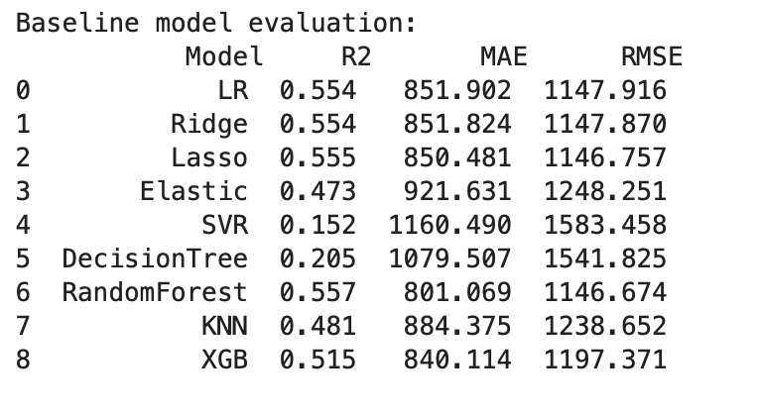
Project analysis slide 11
ML Model
Building
Models Built:
Linear Regression: Simple baseline model to predict sales.
Decision Tree Regression: Captures non-linear relationships by splitting data into subsets.
Random Forest Regression: Ensemble of decision trees to improve accuracy and reduce overfitting.
XGBoost Regression: Advanced ensemble method using gradient boosting for high accuracy and handling complex interactions.
Model Strengths:
Linear Regression: Easy to interpret but limited in capturing complex patterns.
Decision Tree: Captures non-linear relationships but prone to overfitting.
Random Forest: Reduces overfitting, but computationally intensive.
XGBoost: Best performance, handles large datasets and complex relationships, and is robust against overfitting.

Slide 16
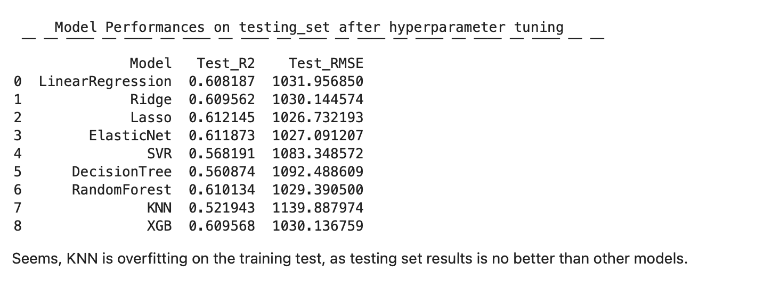
Project analysis slide 11
Model Tuning and
Optimization
Hyperparameter Tuning: Hyperparameter tuning was performed for models like XGBoost and Random Forest using grid search and cross-validation, optimizing parameters like learning rate, max depth, and n_estimators.
Model Selection Criteria: The selection of the optimal model was based on performance metrics such as RMSE, R², and MAE, with XGBoost emerging as the top performer due to its superior accuracy.
Model Refinement: Post-tuning, the model was refined by adjusting features and re-running the optimization process, ensuring that the final model was both accurate and efficient.
Performance Improvements: Tuning and optimization resulted in a significant reduction in RMSE and an increase in R², demonstrating the effectiveness of these techniques in improving model performance.

Slide 17
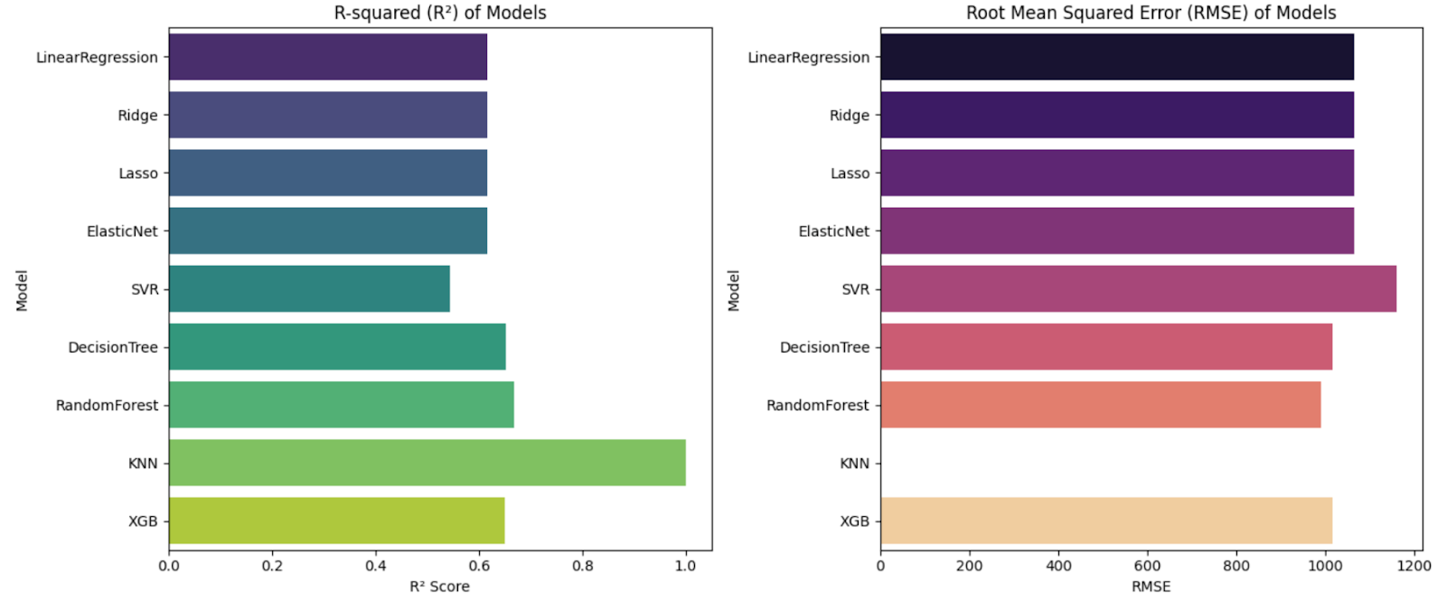
Project analysis slide 11
Model
Evaluation
Key Metrics:
R-squared (R²): Measures the proportion of variance in sales explained by the model (higher is better).
Root Mean Squared Error (RMSE): Indicates the average error magnitude in predictions (lower is better).
Mean Absolute Error (MAE): Provides the average absolute difference between predicted and actual sales.
Cross-Validation:
Applied cross-validation to ensure models generalize well to unseen data, avoiding overfitting.
Model Comparison:
XGBoost outperformed other models with the highest R² and lowest RMSE, demonstrating its ability to accurately predict sales.

Slide 18
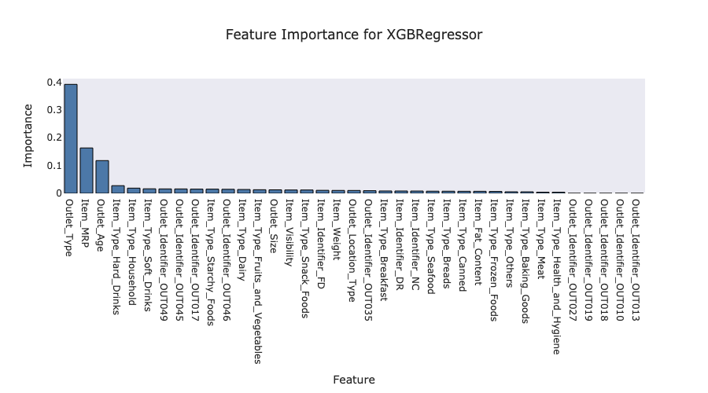
Project analysis slide 11
Feature
Importance
Top Influential Features:
Item_MRP: Most significant predictor of sales, reflecting its direct impact on consumer purchasing decisions.
Outlet_Type and Outlet_Age: Crucial in determining sales performance across different store types and their operational age.
Item_Visibility: Lower visibility often correlated with lower sales, suggesting the importance of product placement.
Insights from Feature Importance:
Emphasizes the need for strategic pricing and understanding outlet characteristics in driving sales.
Suggests potential areas for retailers to focus on, such as optimizing product visibility and targeting specific outlet types.

Slide 19
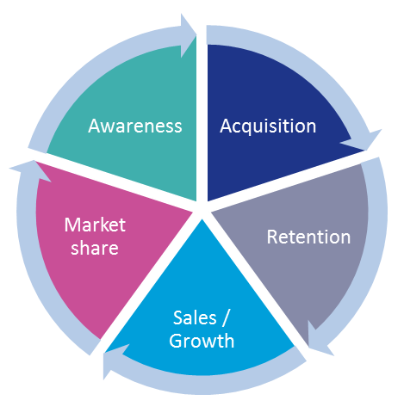
Project analysis slide 11
Business Impact
and Insights
Inventory Optimization: Accurate sales predictions enable better inventory management, reducing instances of overstocking and stockouts, leading to optimized storage and reduced costs.
Pricing Strategy: Insights from the model can inform dynamic pricing strategies, allowing retailers to adjust prices based on predicted demand and maximize revenue.
Targeted Marketing: Retailers can leverage predictions to tailor marketing campaigns, focusing on high-demand products and optimizing promotions to drive sales.
Operational Efficiency: By understanding sales patterns and outlet performance, retailers can streamline operations, focusing resources on high-performing outlets and products.

Slide 20

Project analysis slide 11
Ethical Considerations
and Data Privacy
Data Confidentiality: Ensuring the confidentiality of sales and customer data is paramount. The model and its deployment will adhere to strict data privacy regulations to protect sensitive information.
Bias and Fairness: Efforts have been made to reduce biases in the model, ensuring fair and equitable predictions across all products and outlets, preventing any skewed decision-making.
Transparency in Predictions: The model’s predictions and decision-making process are designed to be transparent, allowing retail managers to understand the rationale behind sales forecasts.

Slide 21

Project analysis slide 11
Conclusion and
Insights
Key Findings:
XGBoost emerged as the best model for predicting retail sales with high accuracy.
Significant features like Item_MRP, Outlet_Type, and Outlet_Age provide actionable insights for retail strategies.
Data preprocessing and feature engineering were critical in enhancing model performance.
Business Implications:
Retailers can use these insights to optimize pricing, inventory management, and store operations.
Accurate sales prediction supports better decision-making, leading to increased profitability and reduced waste.
Next Steps:
Explore time series analysis for incorporating seasonal trends.
Consider deploying the model in a real-time environment to continuously improve its predictions.

Slide 22
Thank You

